Slide 1
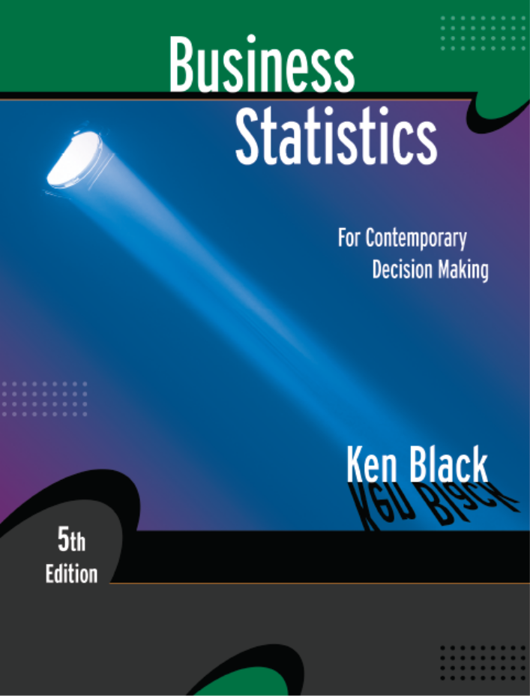
Business Statistics, 5th ed. by Ken Black
Chapter 11
Analysis of
Variance
& Design of Experiments
PowerPoint presentations prepared by Lloyd Jaisingh, Morehead State University

Slide 2
Learning Objectives
Understand the differences between various experimental designs and when to use them.
Compute and interpret the results of a one-way ANOVA.
Compute and interpret the results of a random block design.
Compute and interpret the results of a two-way ANOVA.
Understand and interpret interaction.
Know when and how to use multiple comparison techniques.
Notes:
2

Slide 3
Introduction to Design of Experiments
Experimental Design
- a plan and a structure to test hypotheses in which the researcher controls or manipulates one or more variables.
Notes:
4

Slide 4
Introduction to Design of Experiments
Independent Variable
Treatment variable is one that the experimenter controls or modifies in the experiment.
Classification variable is a characteristic of the experimental subjects that was present prior to the experiment, and is not a result of the experimenter’s manipulations or control.
Levels or Classifications are the subcategories of the independent variable used by the researcher in the experimental design.
Independent variables are also referred to as factors.

Slide 5
Introduction to Design of Experiments
Dependent Variable
the response to the different levels of the independent variables.
Analysis of Variance (ANOVA) – a group of statistical techniques used to analyze experimental designs.

Slide 6
Three Types of Experimental Designs
Completely Randomized Design – subjects are assigned randomly to treatments; single independent variable.
Randomized Block Design – includes a blocking variable; single independent variable.
Factorial Experiments – two or more independent variables are explored at the same time; every level of each factor are studied under every level of all other factors.
Notes:
5

Slide 7
Completely Randomized Design
Machine Operator
1
2
3
4
Valve Opening
Measurements
.
.
.
.
.
.
.
.
.
.
.
.
Notes:
6

Slide 8
Valve Openings by Operator
1 | 2 | 3 | 4
6.33 | 6.26 | 6.44 | 6.29
6.26 | 6.36 | 6.38 | 6.23
6.31 | 6.23 | 6.58 | 6.19
6.29 | 6.27 | 6.54 | 6.21
6.4 | 6.19 | 6.56
 | 6.5 | 6.34
 | 6.19 | 6.58
 | 6.22

Slide 9
Analysis of Variance: Assumptions
Observations are drawn from normally distributed populations.
Observations represent random samples from the populations.
Variances of the populations are equal.
Notes:
8

Slide 10
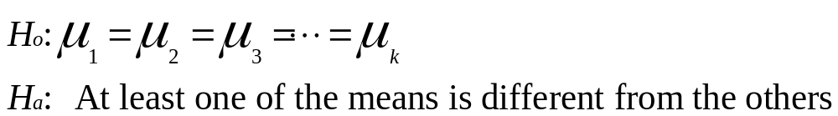
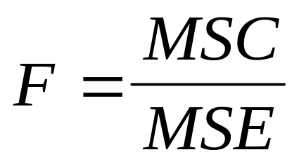
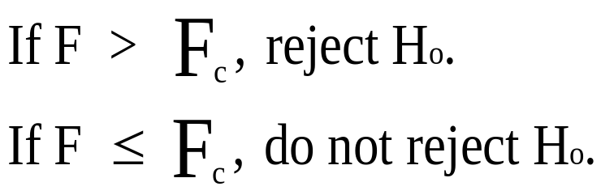
One-Way ANOVA: Procedural Overview
Notes:
9

Slide 11
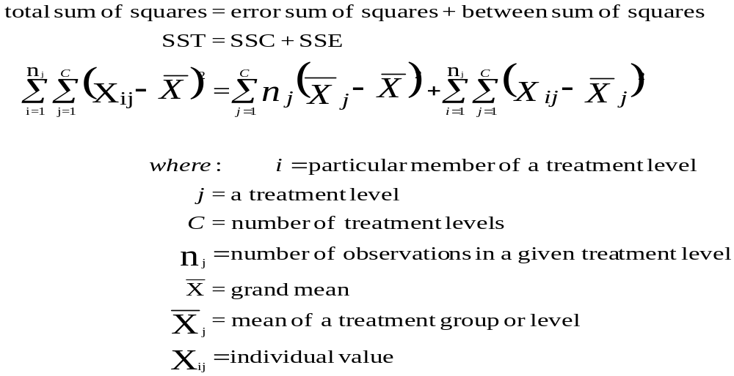
One-Way ANOVA:
Sums of Squares Definitions
Notes:
10

Slide 12
Partitioning Total Sum of Squares of Variation
SST
(Total Sum of Squares)
SSC
(Treatment Sum of Squares)
SSE
(Error Sum of Squares)

Slide 13
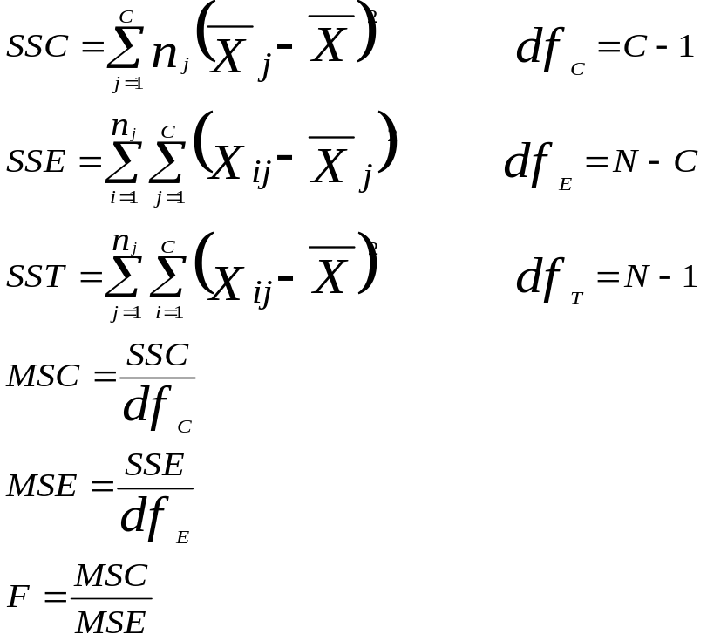
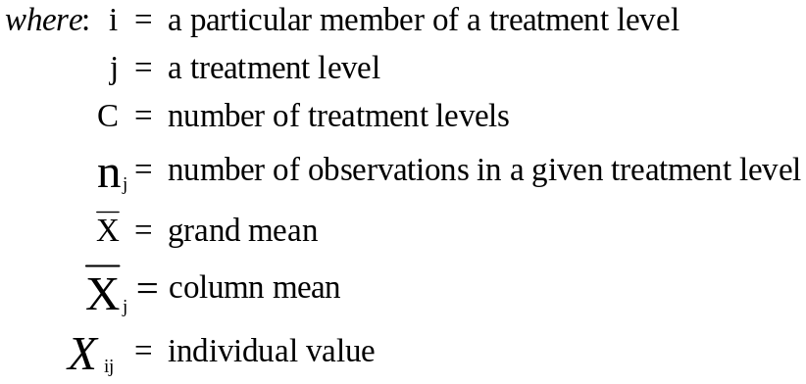
One-Way ANOVA:
Computational Formulas
Notes:
12

Slide 14
One-Way ANOVA:
Preliminary Calculations
 | 1 | 2 | 3 | 4
 | 6.33 | 6.26 | 6.44 | 6.29
 | 6.26 | 6.36 | 6.38 | 6.23
 | 6.31 | 6.23 | 6.58 | 6.19
 | 6.29 | 6.27 | 6.54 | 6.21
 | 6.4 | 6.19 | 6.56
 |  | 6.5 | 6.34
 |  | 6.19 | 6.58
 |  | 6.22
T_{j} | T₁ = 31.59 | T₂ = 50.22 | T₃ = 45.42 | T₄ = 24.92 | T = 152.15
n_{j} | n₁ = 5 | n₂ = 8 | n₃ = 7 | n₄ = 4 | N = 24
Mean | 6.318000 | 6.277500 | 6.488571 | 6.230000 | 6.339583
Notes:
13

Slide 15
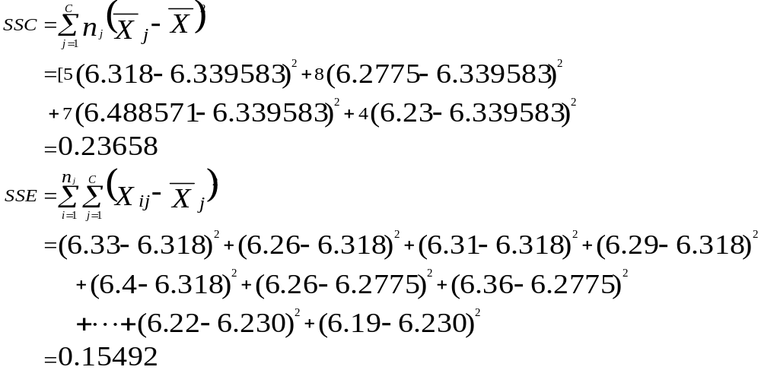
One-Way ANOVA:
Sum of Squares Calculations
Notes:
15

Slide 16
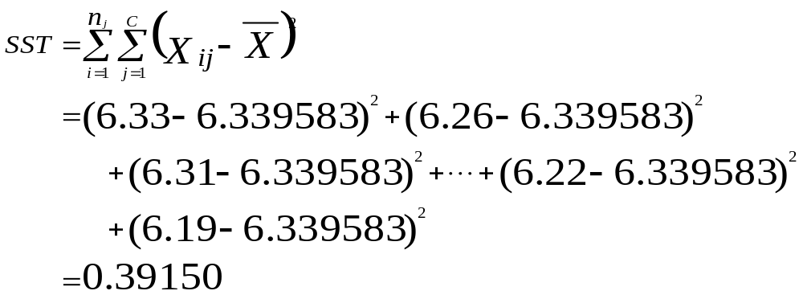
One-Way ANOVA:
Sum of Squares Calculations
Notes:
15

Slide 17
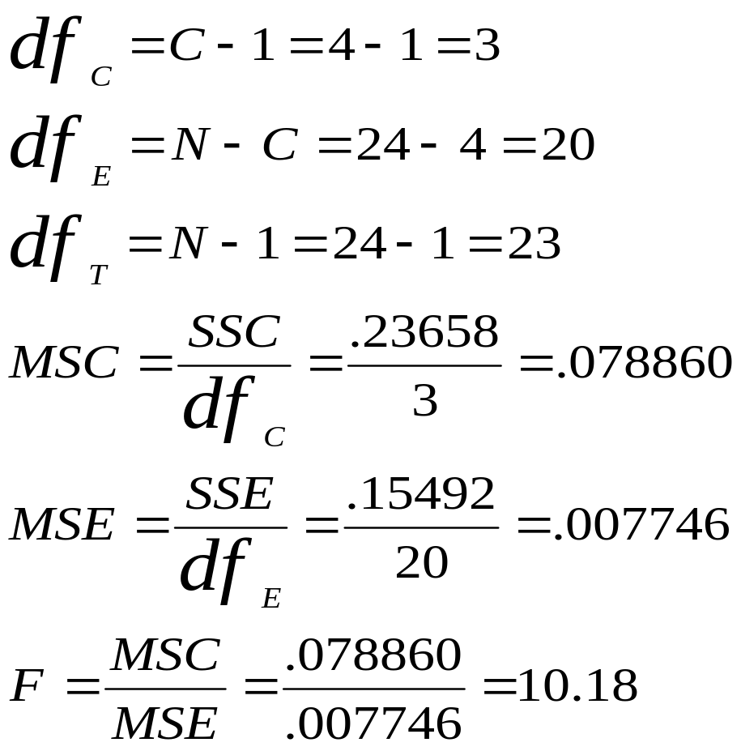
One-Way ANOVA: Mean Square and F Calculations
Notes:
16

Slide 18
Analysis of Variance for Valve Openings
Source of Variance df SS MS F
Between 3 0.23658 0.078860 10.18
Error 20 0.15492 0.007746
Total 23 0.39150
Notes:
17

Slide 19
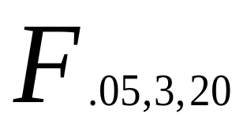
A Portion of the F Table for α = 0.05
df₁
 | 1 | 2 | 3 | 4 | 5 | 6 | 7 | 8 | 9
1 | 161.45 | 199.50 | 215.71 | 224.58 | 230.16 | 233.99 | 236.77 | 238.88 | 240.54
… | … | … | … | … | … | … | … | … | …
18 | 4.41 | 3.55 | 3.16 | 2.93 | 2.77 | 2.66 | 2.58 | 2.51 | 2.46
19 | 4.38 | 3.52 | 3.13 | 2.90 | 2.74 | 2.63 | 2.54 | 2.48 | 2.42
20 | 4.35 | 3.49 | 3.10 | 2.87 | 2.71 | 2.60 | 2.51 | 2.45 | 2.39
21 | 4.32 | 3.47 | 3.07 | 2.84 | 2.68 | 2.57 | 2.49 | 2.42 | 2.37
df ₂
df₂

Slide 20
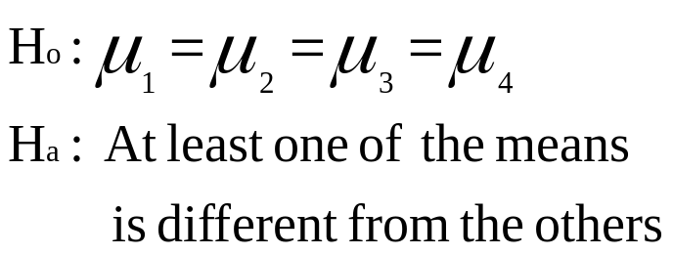
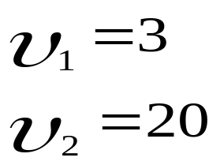
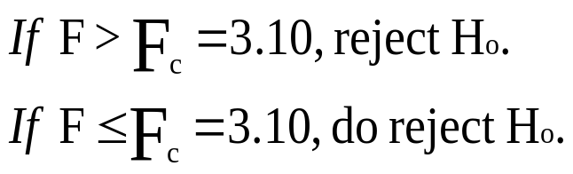

One-Way ANOVA:
Procedural Summary
Rejection Region
Non rejection
Region
α = .05
Since
F
=
10.18
F
=
>
3
.
10
,
reject
H
o
.
c
Critical Value
Notes:
19

Slide 21
Excel Output for the Valve Opening Example
Anova: Single Factor
SUMMARY
Groups | Count | Sum | Average | Variance
Operator 1 | 5 | 31.59 | 6.318 | 0.00277
Operator 2 | 8 | 50.22 | 6.2775 | 0.0110786
Operator 3 | 7 | 45.42 | 6.488571429 | 0.0101143
Operator 4 | 4 | 24.92 | 6.23 | 0.0018667
ANOVA
Source of Variation | SS | df | MS | F | P-value | F crit
Between Groups | 0.236580119 | 3 | 0.07886004 | 10.181025 | 0.00028 | 3.09839
Within Groups | 0.154915714 | 20 | 0.007745786
Total | 0.391495833 | 23

Slide 22
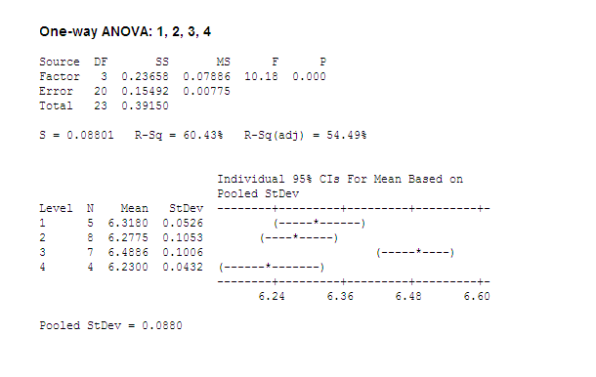
MINITAB Output for the Valve Opening Example

Slide 23
Multiple Comparison Tests
An analysis of variance (ANOVA) test is an overall test of differences among groups.
Multiple Comparison techniques are used to identify which pairs of means are significantly different given that the ANOVA test reveals overall significance.
Tukey’s honestly significant difference (HSD) test requires equal sample sizes
Tukey-Kramer Procedure is used when sample sizes are unequal.
Notes:
22

Slide 24
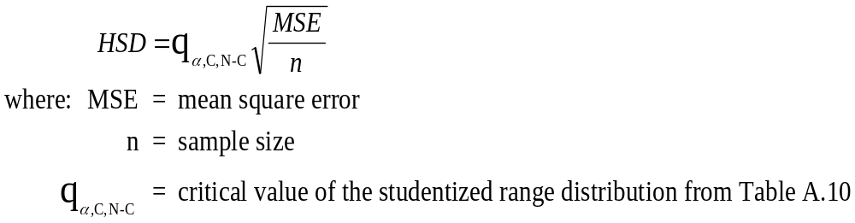
Tukey’s Honestly Significant Difference (HSD) Test
Notes:
23

Slide 25
Data from Demonstration Problem 11.1
PLANT (Employee Age)
1 2 3
29 32 25
27 33 24
30 31 24
27 34 25
28 30 26
Group Means 28.2 32.0 24.8
n_{j} 5 5 5
C = 3
df_{E} = N - C = 12 MSE = 1.63
Notes:
24

Slide 26
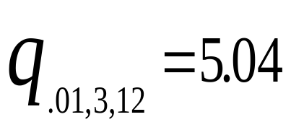
q Values for α = .01
Number of Populations
Degrees of Freedom
2
3
4
5
...
1
90
135
164
186
2
14
19
22.3
24.7
3
8.26
10.6
12.2
13.3
4
6.51
8.12
9.17
9.96
.
.
11
4.39
5.14
5.62
5.97
12
4.32
5.04
5.50
5.84
Notes:
25

Slide 27
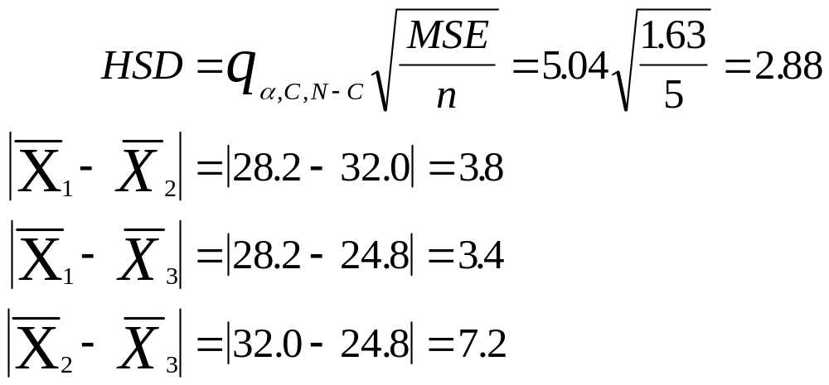
Tukey’s HSD Test for the Employee Age Data
Notes:
26

Slide 28
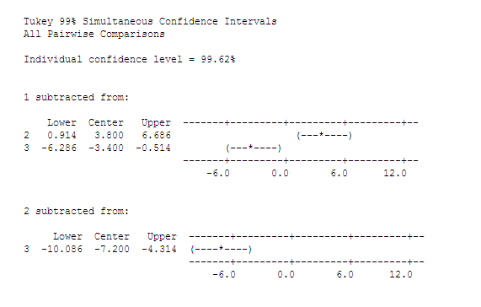
Tukey’s HSD Test for the Employee Age Data using MINITAB
Intervals
do not
contain 0,
so significant
differences
between the
means.
Notes:
26

Slide 29
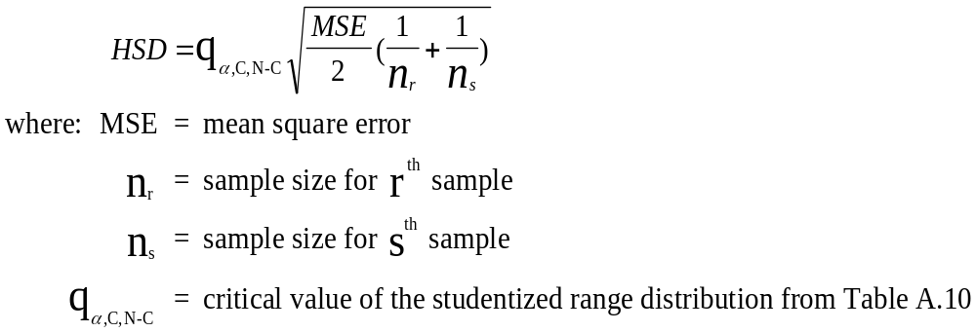
Tukey-Kramer Procedure:
The Case of Unequal Sample Sizes
Notes:
27

Slide 30
Freighter Example: Means and
Sample Sizes for the Four Operators
Operator
Sample Size
Mean
1
5
6.3180
2
8
6.2775
3
7
6.4886
4
4
6.2300

Slide 31
Tukey-Kramer Results for the Four Operators
Critical
|Actual
Pair
Difference
Differences|
1 and 2
.1405
.0405
1 and 3
.1443
.1706*
1 and 4
.1653
.0880
2 and 3
.1275
.2111*
2 and 4
.1509
.0475
3 and 4
.1545
.2586*
*denotes significant at
α =
.05

Slide 32
Partitioning the Total Sum of Squares in the Randomized Block Design
SST
(Total Sum of Squares)
SSE
(Error Sum of Squares)
SSC
(Treatment
Sum of Squares)
SSR
(Sum of Squares
Blocks)
SSE’
(Sum of Squares
Error)

Slide 33
A Randomized Block Design
Single Independent Variable
Blocking
Variable
.
.
Individual
observations
.
.
.
.
.
.
.
.
.
.
.
.
.
.
.
Notes:
30

Slide 34
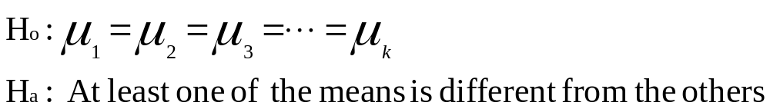
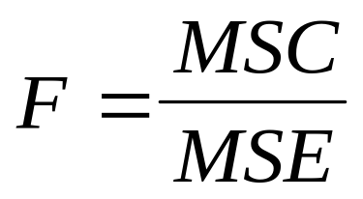
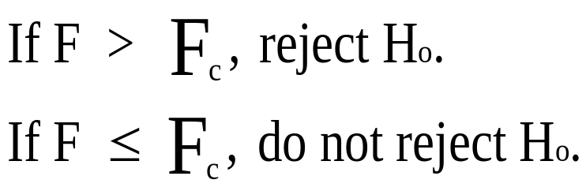
Randomized Block Design Treatment Effects: Procedural Overview
Notes:
32

Slide 35
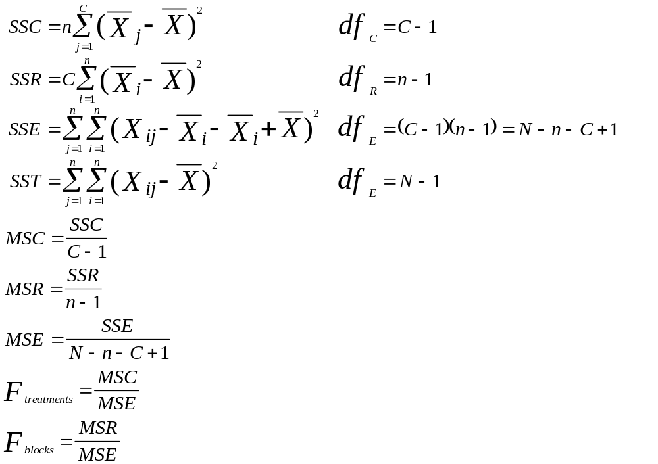
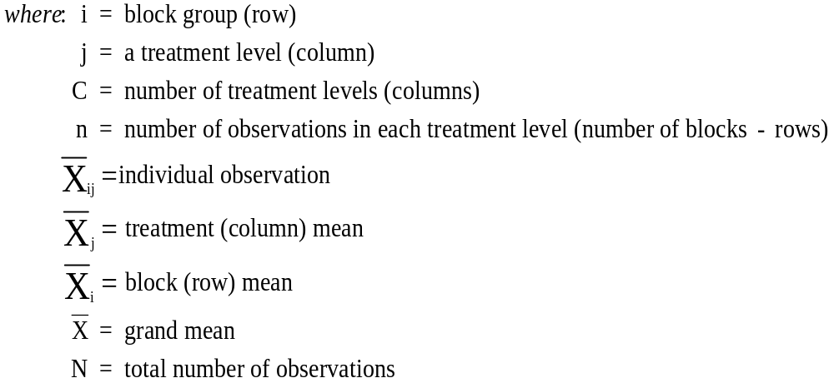
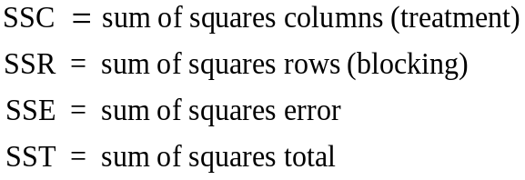
Randomized Block Design:
Computational Formulas
Notes:
34

Slide 36

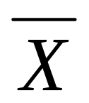

Randomized Block Design:
Tread-Wear Example
Speed
Supplier
Slow
Medium
Fast
Block Means ( )
1
3.7
4.5
3.1
3.77
2
3.4
3.9
2.8
3.37
N = 15
n = 5
3
3.5
4.1
3.0
3.53
4
3.2
3.5
2.6
3.10
5
3.9
4.8
3.4
4.03
Treatment Means( )
3.54
4.16
2.98
3.56
C = 3
Notes:
35

Slide 37
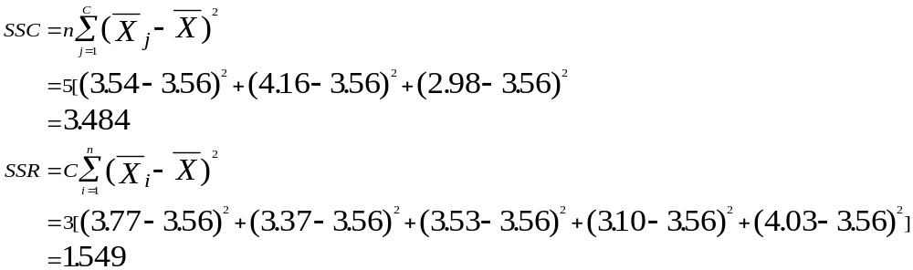
Randomized Block Design:
Sum of Squares Calculations (Part 1)
Notes:
36

Slide 38
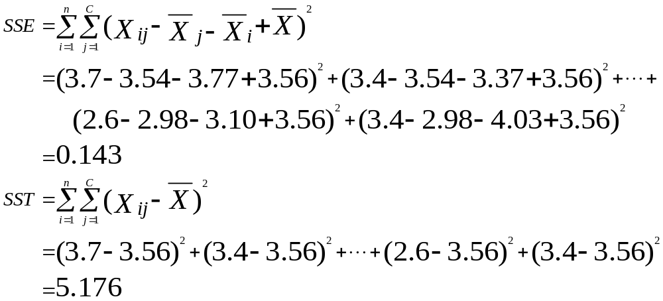
Randomized Block Design:
Sum of Squares Calculations (Part 2)

Slide 39
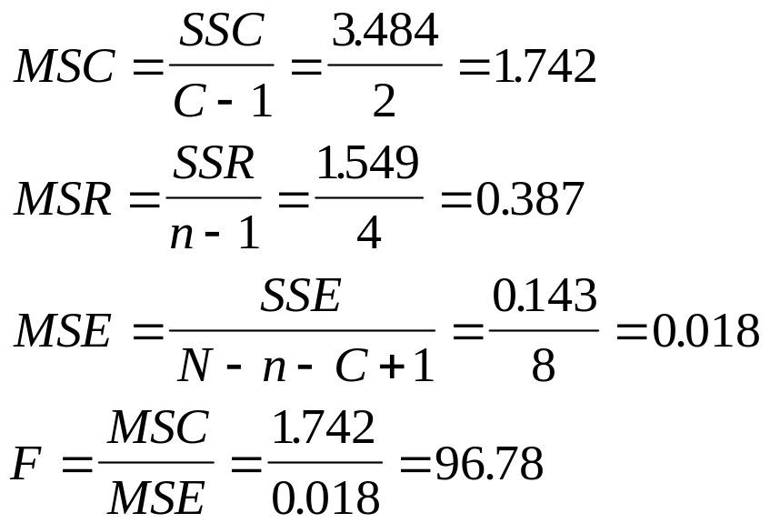
Randomized Block Design:
Mean Square Calculations

Slide 40
Analysis of Variance for the Tread-Wear Example
Source of Variance SS df MS F
Treatment 3.484 2 1.742 96.78
Block 1.549 4 0.387 21.50
Error 0.143 8 0.018
Total 5.176 14
Notes:
39

Slide 41
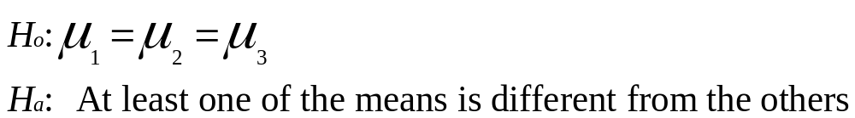
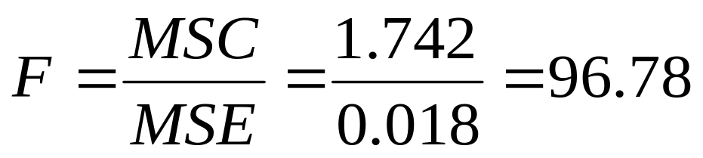
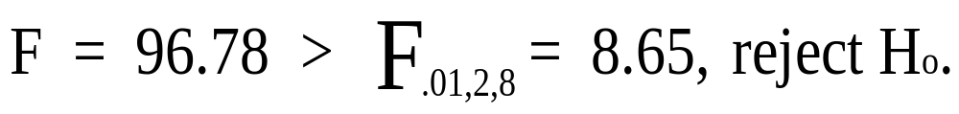
Randomized Block Design Treatment Effects: Procedural Summary
Notes:
40

Slide 42
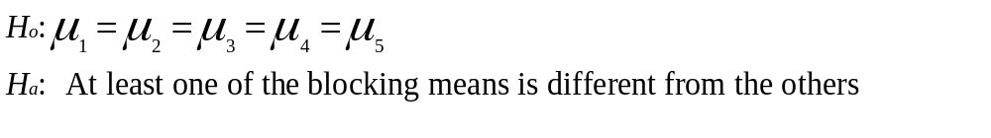
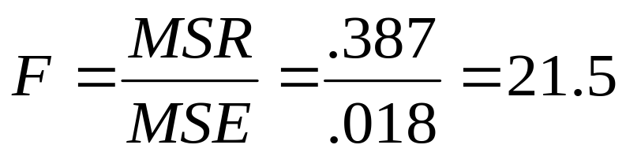
Randomized Block Design Blocking Effects: Procedural Overview
Notes:
41

Slide 43
Excel Output for Tread-Wear Example: Randomized Block Design
Anova: Two-Factor Without Replication
SUMMARY
Count
Sum
Average
Variance
Supplier 1
3
11.3
3.7666667
0.4933333
Supplier 2
3
10.1
3.3666667
0.3033333
Supplier 3
3
10.6
3.5333333
0.3033333
Supplier 4
3
9.3
3.1
0.21
Supplier 5
3
12.1
4.0333333
0.5033333
Slow
5
17.7
3.54
0.073
Medium
5
20.8
4.16
0.258
Fast
5
14.9
2.98
0.092
ANOVA
Source of Variation
SS
df
MS
F
P-value
F crit
Rows
1.5493333
4
0.3873333
21.719626
0.0002357
7.0060651
Columns
3.484
2
1.742
97.682243
2.395E-06
8.6490672
Error
0.1426667
8
0.0178333
Total
5.176
14

Slide 44
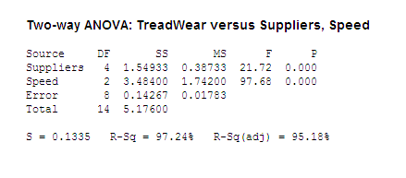
MINITAB Output for Tread-Wear Example: Randomized Block Design
Blocking variable
≡ Suppliers

Slide 45
Two-Way Factorial Design
Column Treatment
Row
Treatment
.
.
Cells
.
.
.
.
.
.
.
.
.
.
.
.
.
.
.
Notes:
43

Slide 46
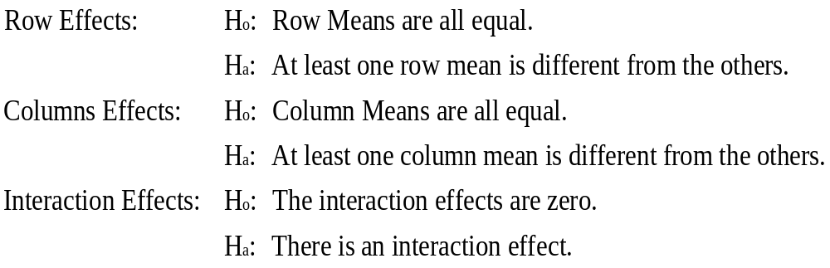
Two-Way ANOVA: Hypotheses
Notes:
44

Slide 47
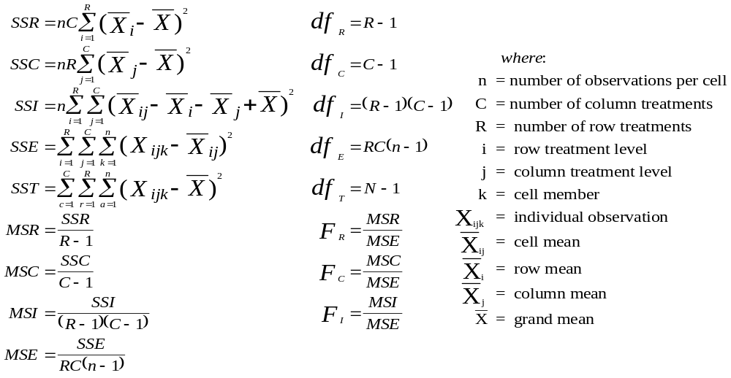
Formulas for Computing a Two-Way ANOVA
Notes:
45

Slide 48
A 2 × 3 Factorial Design with Interaction
Row effects
Cell
Means
R₁
R₂
C₁
C2
C₃
Column
Notes:
46

Slide 49
A 2 × 3 Factorial Design with Some Interaction
Row effects
Cell
Means
R₁
R₂
C₁
C₂
C₃
Column
Notes:
47

Slide 50
A 2 × 3 Factorial Design with No Interaction
Row effects
Cell
Means
R₁
R₂
C₁
C₂
C₃
Column
Notes:
48

Slide 51
A 2 × 3 Factorial Design: Data and Measurements for CEO Dividend Example
Location Where Company
Stock is Traded
How Stockholders are Informed of Dividends
NYSE
AMEX
OTC
X_{i}
Annual/Quarterly Reports
2
1
2
1
2
3
3
2
4
3
4
3
2.5
N = 24
n = 4
X₁₁=1.5
X₁₂=2.5
X₁₃=3.5
X=2.7083
Presentations to Analysts
2
3
1
2
3
3
2
4
4
4
3
4
2.9167
X₂₁=2.0
X₂₂=3.0
X₂₃=3.75
X_{j}
1.75
2.75
3.625
Notes:
49

Slide 52
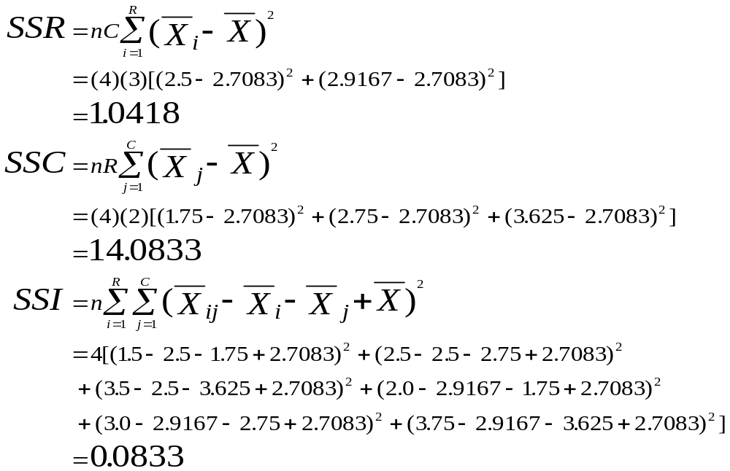
A 2 × 3 Factorial Design: Calculations for the CEO Dividend Example (Part 1)
Notes:
50

Slide 53
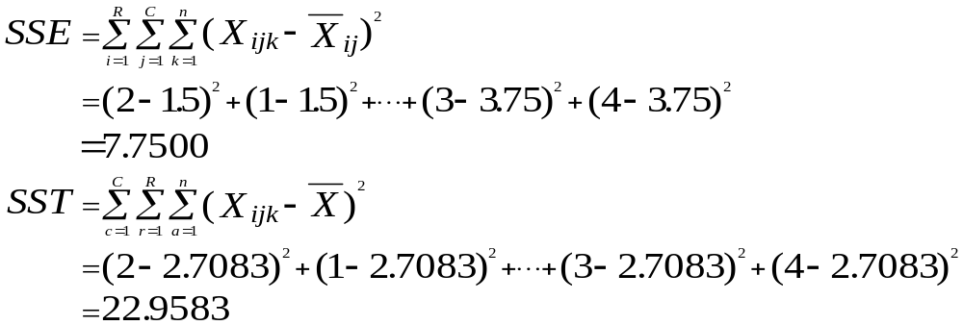
A 2 × 3 Factorial Design: Calculations for the CEO Dividend Example (Part 2)

Slide 54
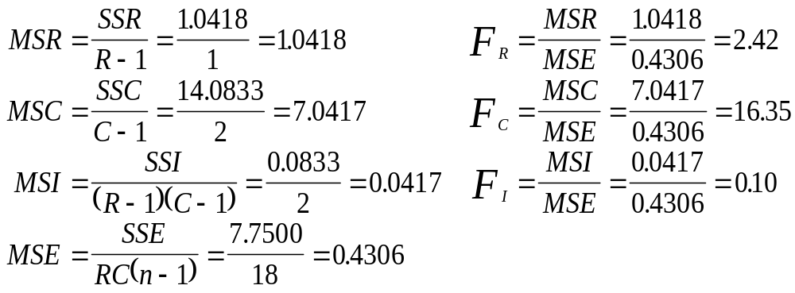
A 2 × 3 Factorial Design: Calculations for the CEO Dividend Example (Part 3)
Notes:
52

Slide 55
Analysis of Variance for the CEO Dividend Problem
Source of Variance SS df MS F
Row 1.0418 1 1.0418 2.42
Column 14.0833 2 7.0417 16.35*
Interaction 0.0833 2 0.0417 0.10
Error 7.7500 18 0.4306
Total 22.9583 23
*Denotes significance at α = .01.
Notes:
53

Slide 56
Excel Output for the CEO Dividend
Example (Part 1)
Anova: Two-Factor With Replication
SUMMARY
NYSE
ASE
OTC
Total
AQReport
Count
4
4
4
12
Sum
6
10
14
30
Average
1.5
2.5
3.5
2.5
Variance
0.3333
0.3333
0.3333
1
Presentation
Count
4
4
4
12
Sum
8
12
15
35
Average
2
3
3.75
2.9167
Variance
0.6667
0.6667
0.25
0.9924
Total
Count
8
8
8
Sum
14
22
29
Average
1.75
2.75
3.625
Variance
0.5
0.5
0.2679

Slide 57
Excel Output for the
CEO Dividend Example (Part 2)
ANOVA
Source of Variation
SS
df
MS
F
P-value
F crit
Sample
1.0417
1
1.0417
2.4194
0.1373
4.4139
Columns
14.083
2
7.0417
16.355
9E-05
3.5546
Interaction
0.0833
2
0.0417
0.0968
0.9082
3.5546
Within
7.75
18
0.4306
Total
22.958
23

Slide 58
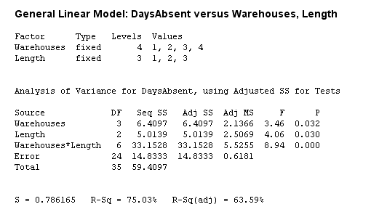
MINITAB Output for the
Demonstration Problem 11.4:

Slide 59
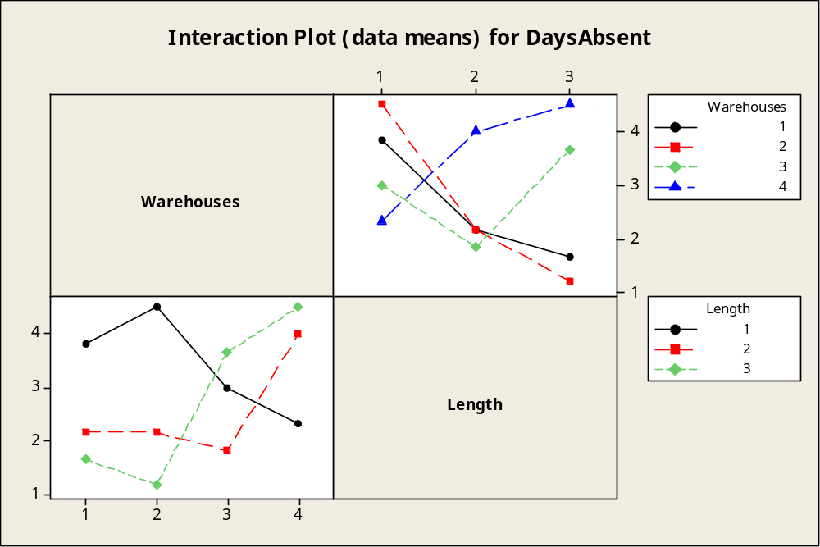
MINITAB Output for the
Demonstration Problem 11.4: Interaction Plots

Slide 60
Copyright 2008 John Wiley & Sons, Inc.
All rights reserved. Reproduction or translation of this work beyond that permitted in section 117 of the 1976 United States Copyright Act without express permission of the copyright owner is unlawful. Request for further information should be addressed to the Permissions Department, John Wiley & Sons, Inc. The purchaser may make back-up copies for his/her own use only and not for distribution or resale. The Publisher assumes no responsibility for errors, omissions, or damages caused by the use of these programs or from the use of the information herein.

